Slide 1
Music.Py ♫♫♫♫
Group Members: Sandy Stoudemire, KayJay Ramsey, Mahan Abbasian, Junn Kim

Slide 2


Class Activity: Which song makes you feel good?

Slide 3


What is Valence sound?
“Valence” is used to describe whether something is likely to make someone feel happy (positive valence) or sad (negative valence).

Slide 4
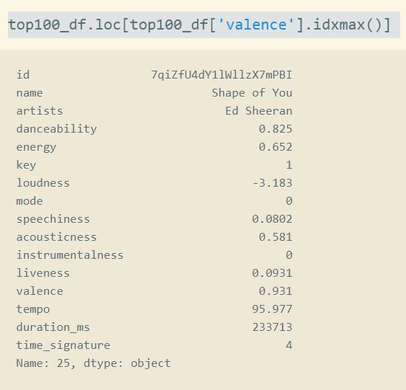
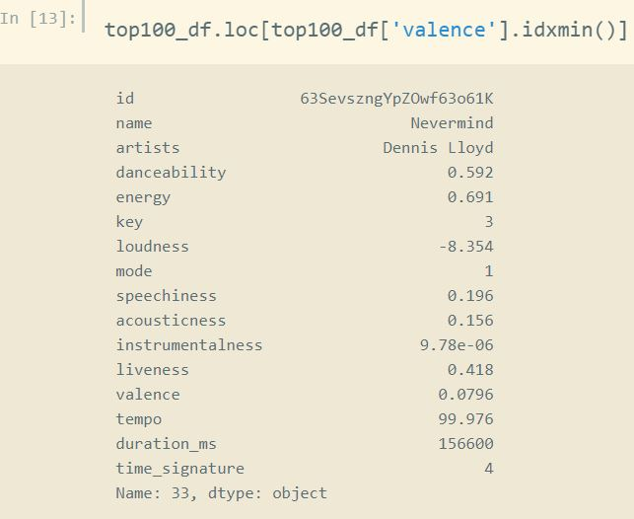
Min/Max Valence vs Song Rank

Slide 5
Motivation & Summary
In this group project, we originally wanted to compare several different musical attributes to see the similarities of each song. With those comparisons, we observed the traits that played a factor within the song ranking. As we begin to analyze our dataset, we were motivated to see if we could plot musical emotion. Does comparing musical emotion (valence) play a key factor in song ranking?
We all love music!
A global scope
API for music? Why not?
Notes:
Mention why we decided to use Spotify

Slide 6


Spotify is a digital musical service that gives you access to millions of songs.
Over 180mil active users
Spotify has more than 83 million paid subscribers and has about 40% of the global music streaming market

Slide 7
Data
Spotify URI for the playlist
Name of the song
Artist(s) of the song
Audio features for the song (such as danceability, tempo, key etc.)
Measurements of each audio features

Slide 8
Data Cleanup & Exploration
Kaggle
From top 10 songs to top 100 songs
API to CSV
Removal of ‘instrumentalness’’ as one of the musical attributes

Slide 9
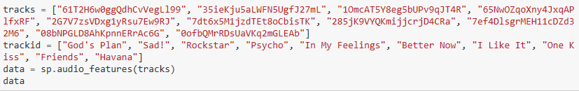
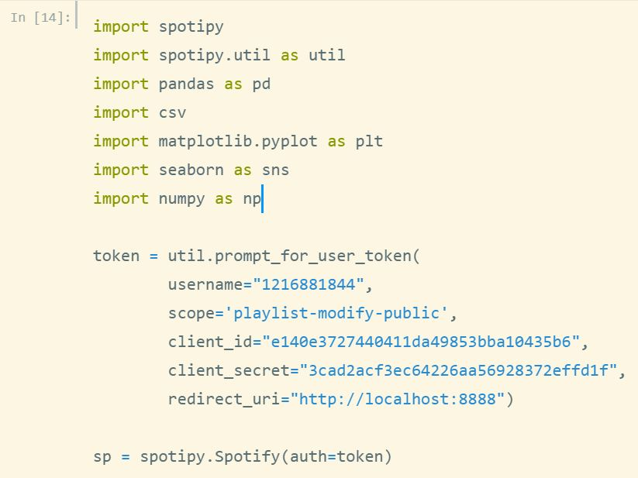
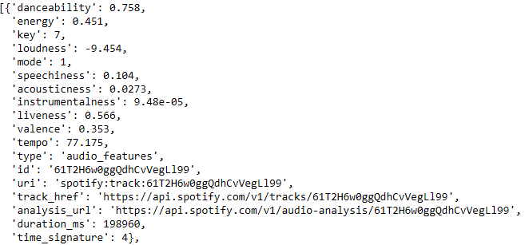
Spotify API

Slide 10
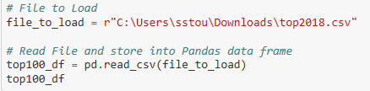
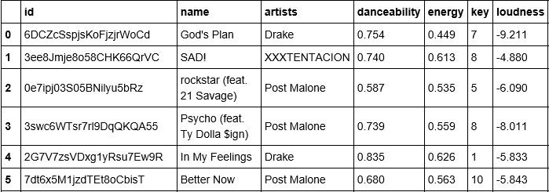
Spotify CSV

Slide 11
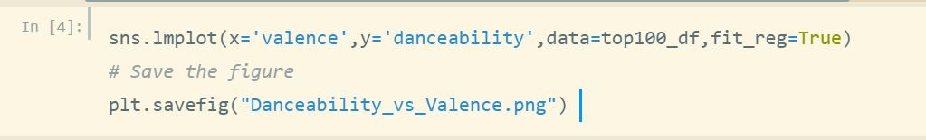
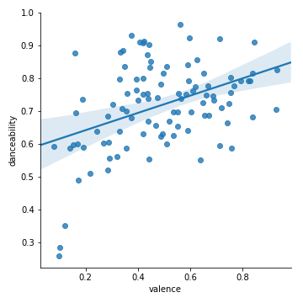
Correlation between Danceability and Song Mood

Slide 12
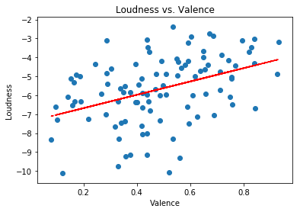
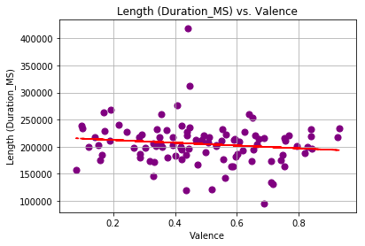
Correlation between Loudness and Length vs Valence

Slide 13
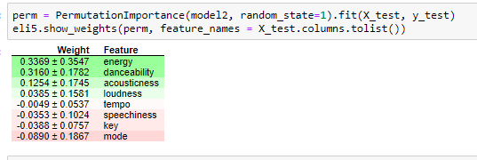
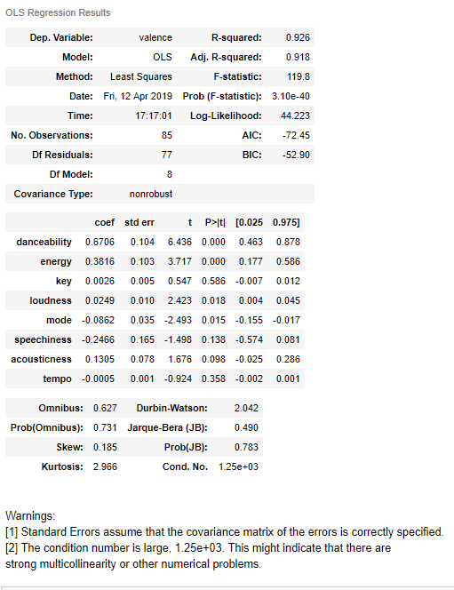
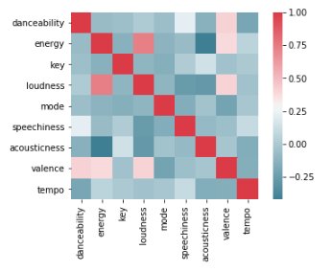
Using Linear Regression

Slide 14
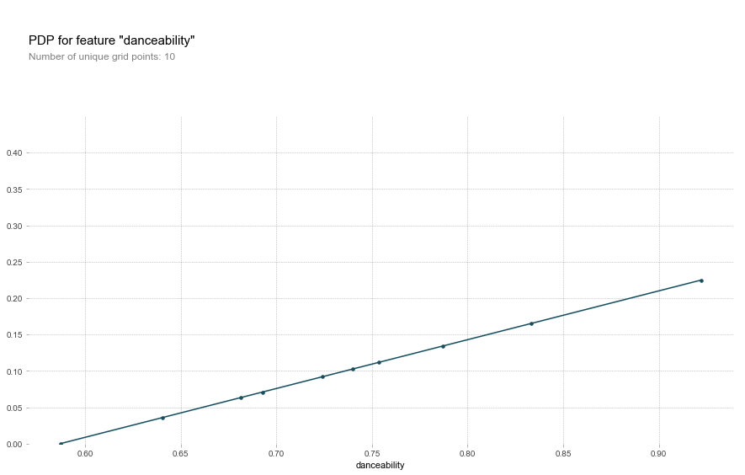
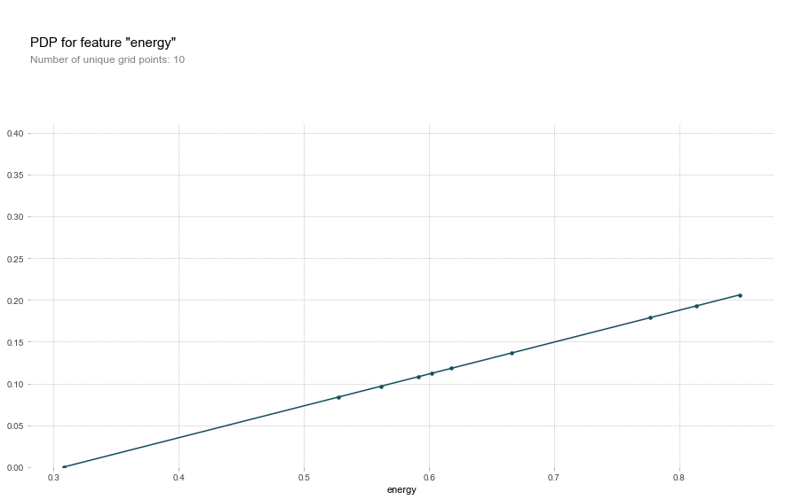
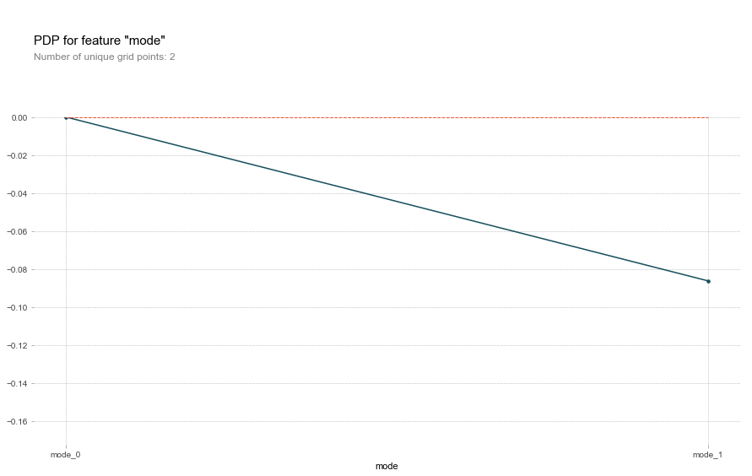
How do these Factors Impact Valence?

Slide 15
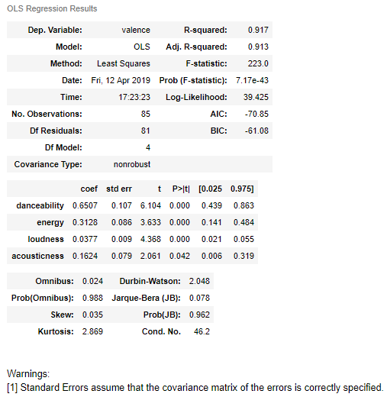
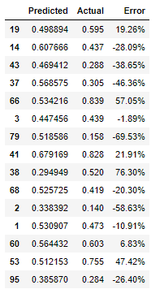
Maybe a better model?

Slide 16
Conclusions
-Based on our findings, valence is not the driving factor that determines a listener's overall opinion of a song. The two examples that we used, Ed Sherran “Shape of You” had the highest valence out of our 100 song dataset, however was ranked number 25 overall. The song “Nevermind” by Dennis Lloyd had the lowest valence value and was ranked number 33 overall.
-One of the major correlated values to valence is danceability and energy, implying people in general will like songs that induce positive energy and emotion.
-Valence does not determine whether a song is a hit or not. Most of the songs are pretty much in the same range with most of the musical attributes.

Slide 17
Additional Questions
-Based on genre, are songs getting happier or sadder?
-Did we need a bigger dataset? Spotify API only allows you to pull 50 songs per request.
-One of the attributes like ‘genre’ was not included. In addition to our observations, it would have been interesting to see if valence values differ amongst the male or female gender.
-With our regression calculations can a algorithm be created that can determine whether a song will have a positive or negative impact on a person?

Slide 18
Questions ??
OPEN-FLOOR Q&A WITH THE AUDIENCE

